Slide 1

Website interacting with Database
Muhammad Saad – 2112118

Slide 2

Webpage
In this project we have created a University Application form using HTML and CSS. In this form we have used many different tags of HTML and also used CSS for adding style to the page.
For the homepage we used HTML and CSS.
On the top of the page we inserted the University logo .
We also added some other options like Admission, Courses, Contact,Pages.
In the end we have a sign-up page link which directs you to the other page.

Slide 3
SIGN-UP PAGE
For making the sign-up page we used inline CSS to make it looks attractive.
We make a form where the user can input the data
We use some tags like table border, alignment, background e.t.c
It has a submit button when you click it. It direct you to new page with a text “Registration successful”

Slide 4
Database
We connect our HTML form with the SQL database.
We use PHP for making a connection between form and database
First we make a database and then our desired data fields we want.

Slide 5
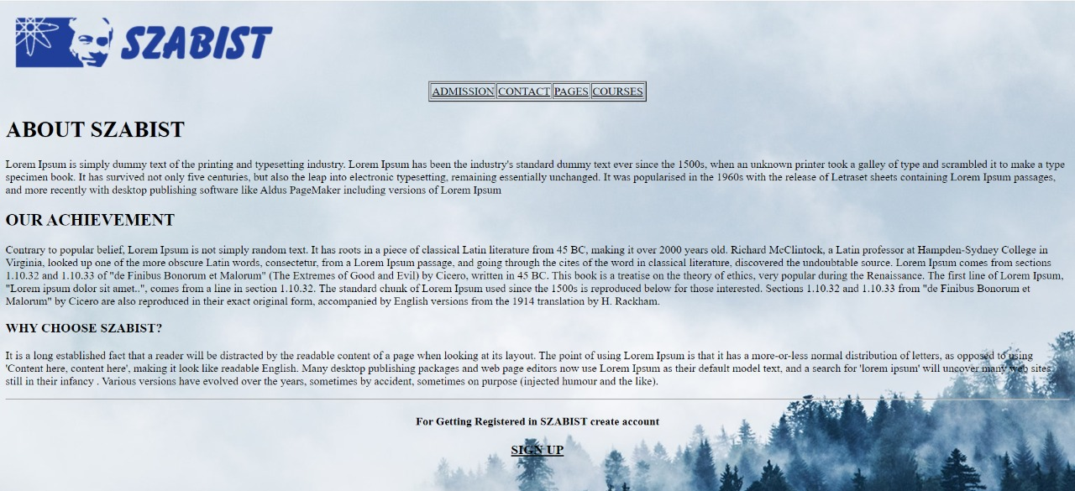
THE OUTPUT

Slide 6
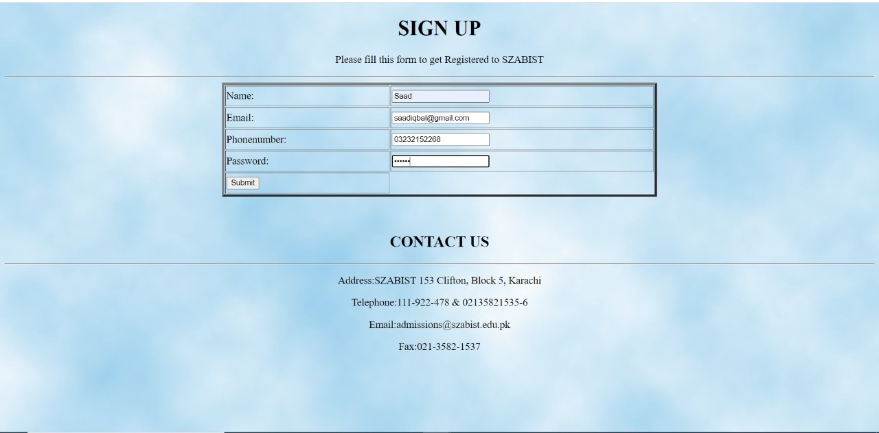
THE OUTPUT

Slide 7
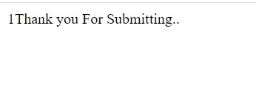
THE OUTPUT

Slide 8
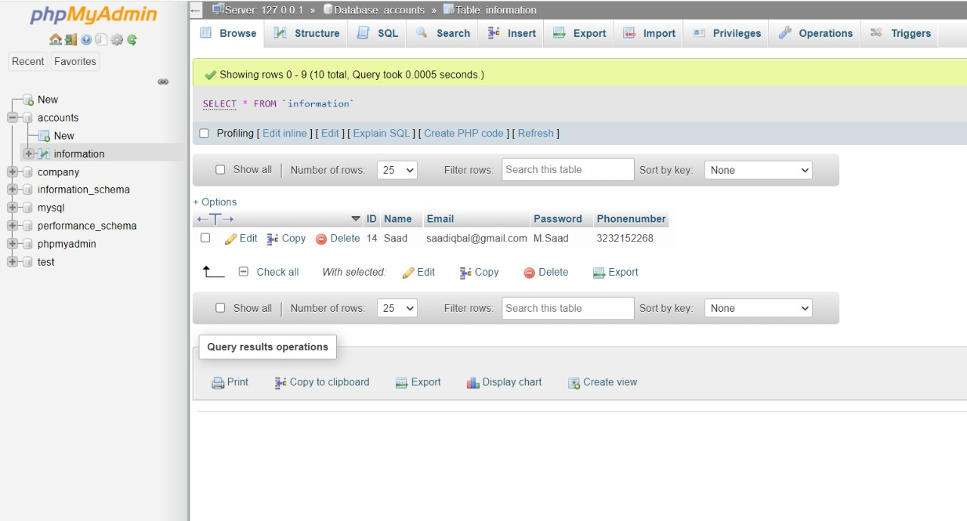
THE OUTPUT

Slide 9

Conclusion
This project is all about how you can connect your website with the SQL database .

